Slide 1
Efficient Size-Bounded Community Search over Large Networks
Kai Yao Lijun Chang
Notes:
Hello, everyone, Im Kai Yao, It’s my pleasure to present our work, “…”.

Slide 2

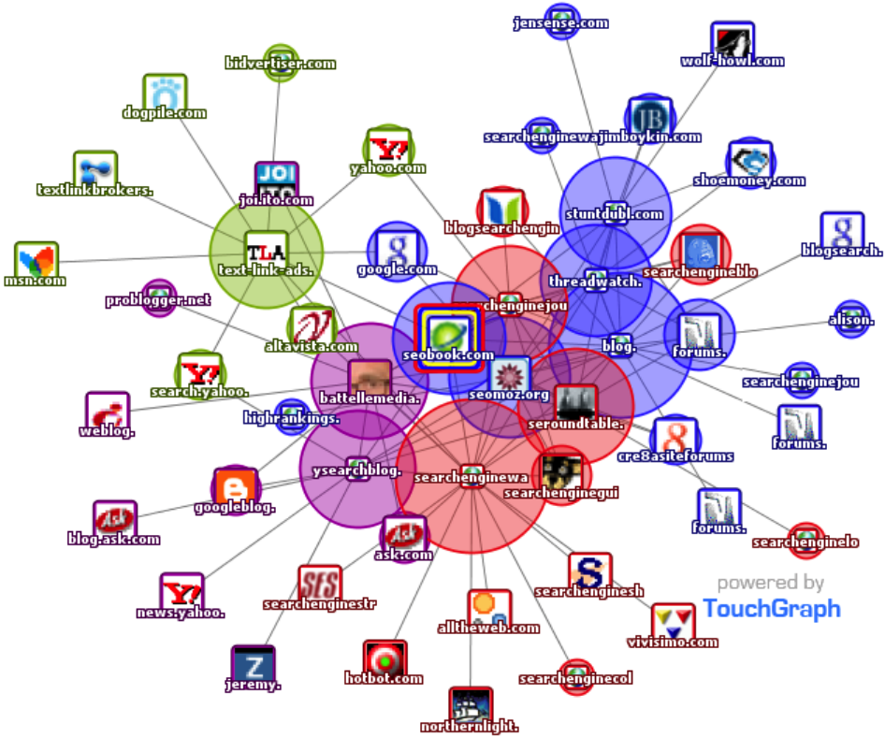
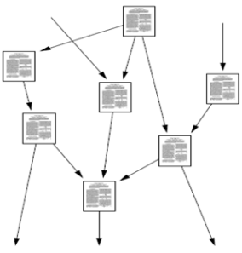
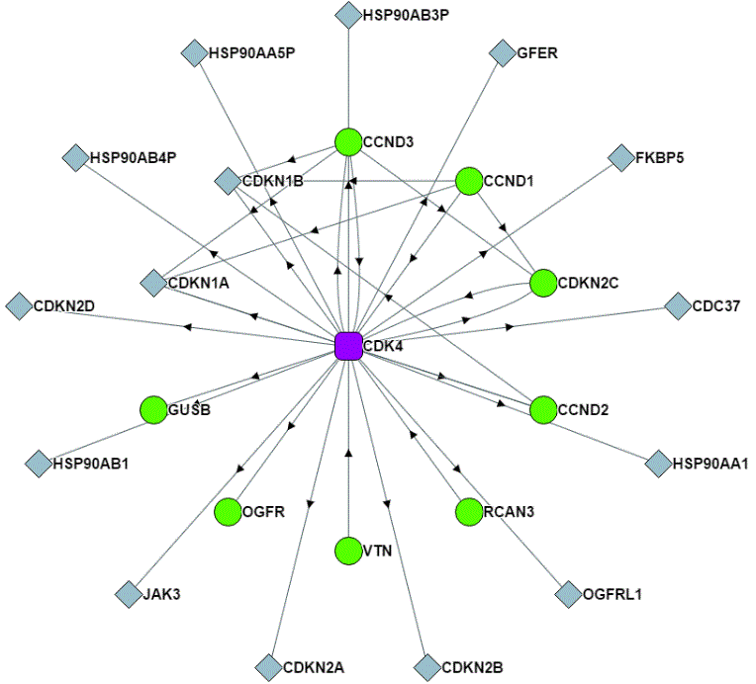
Introduction
Networks are everywhere.
Social Networks
Web Graphs
Citation Networks
Biological Networks

Slide 3
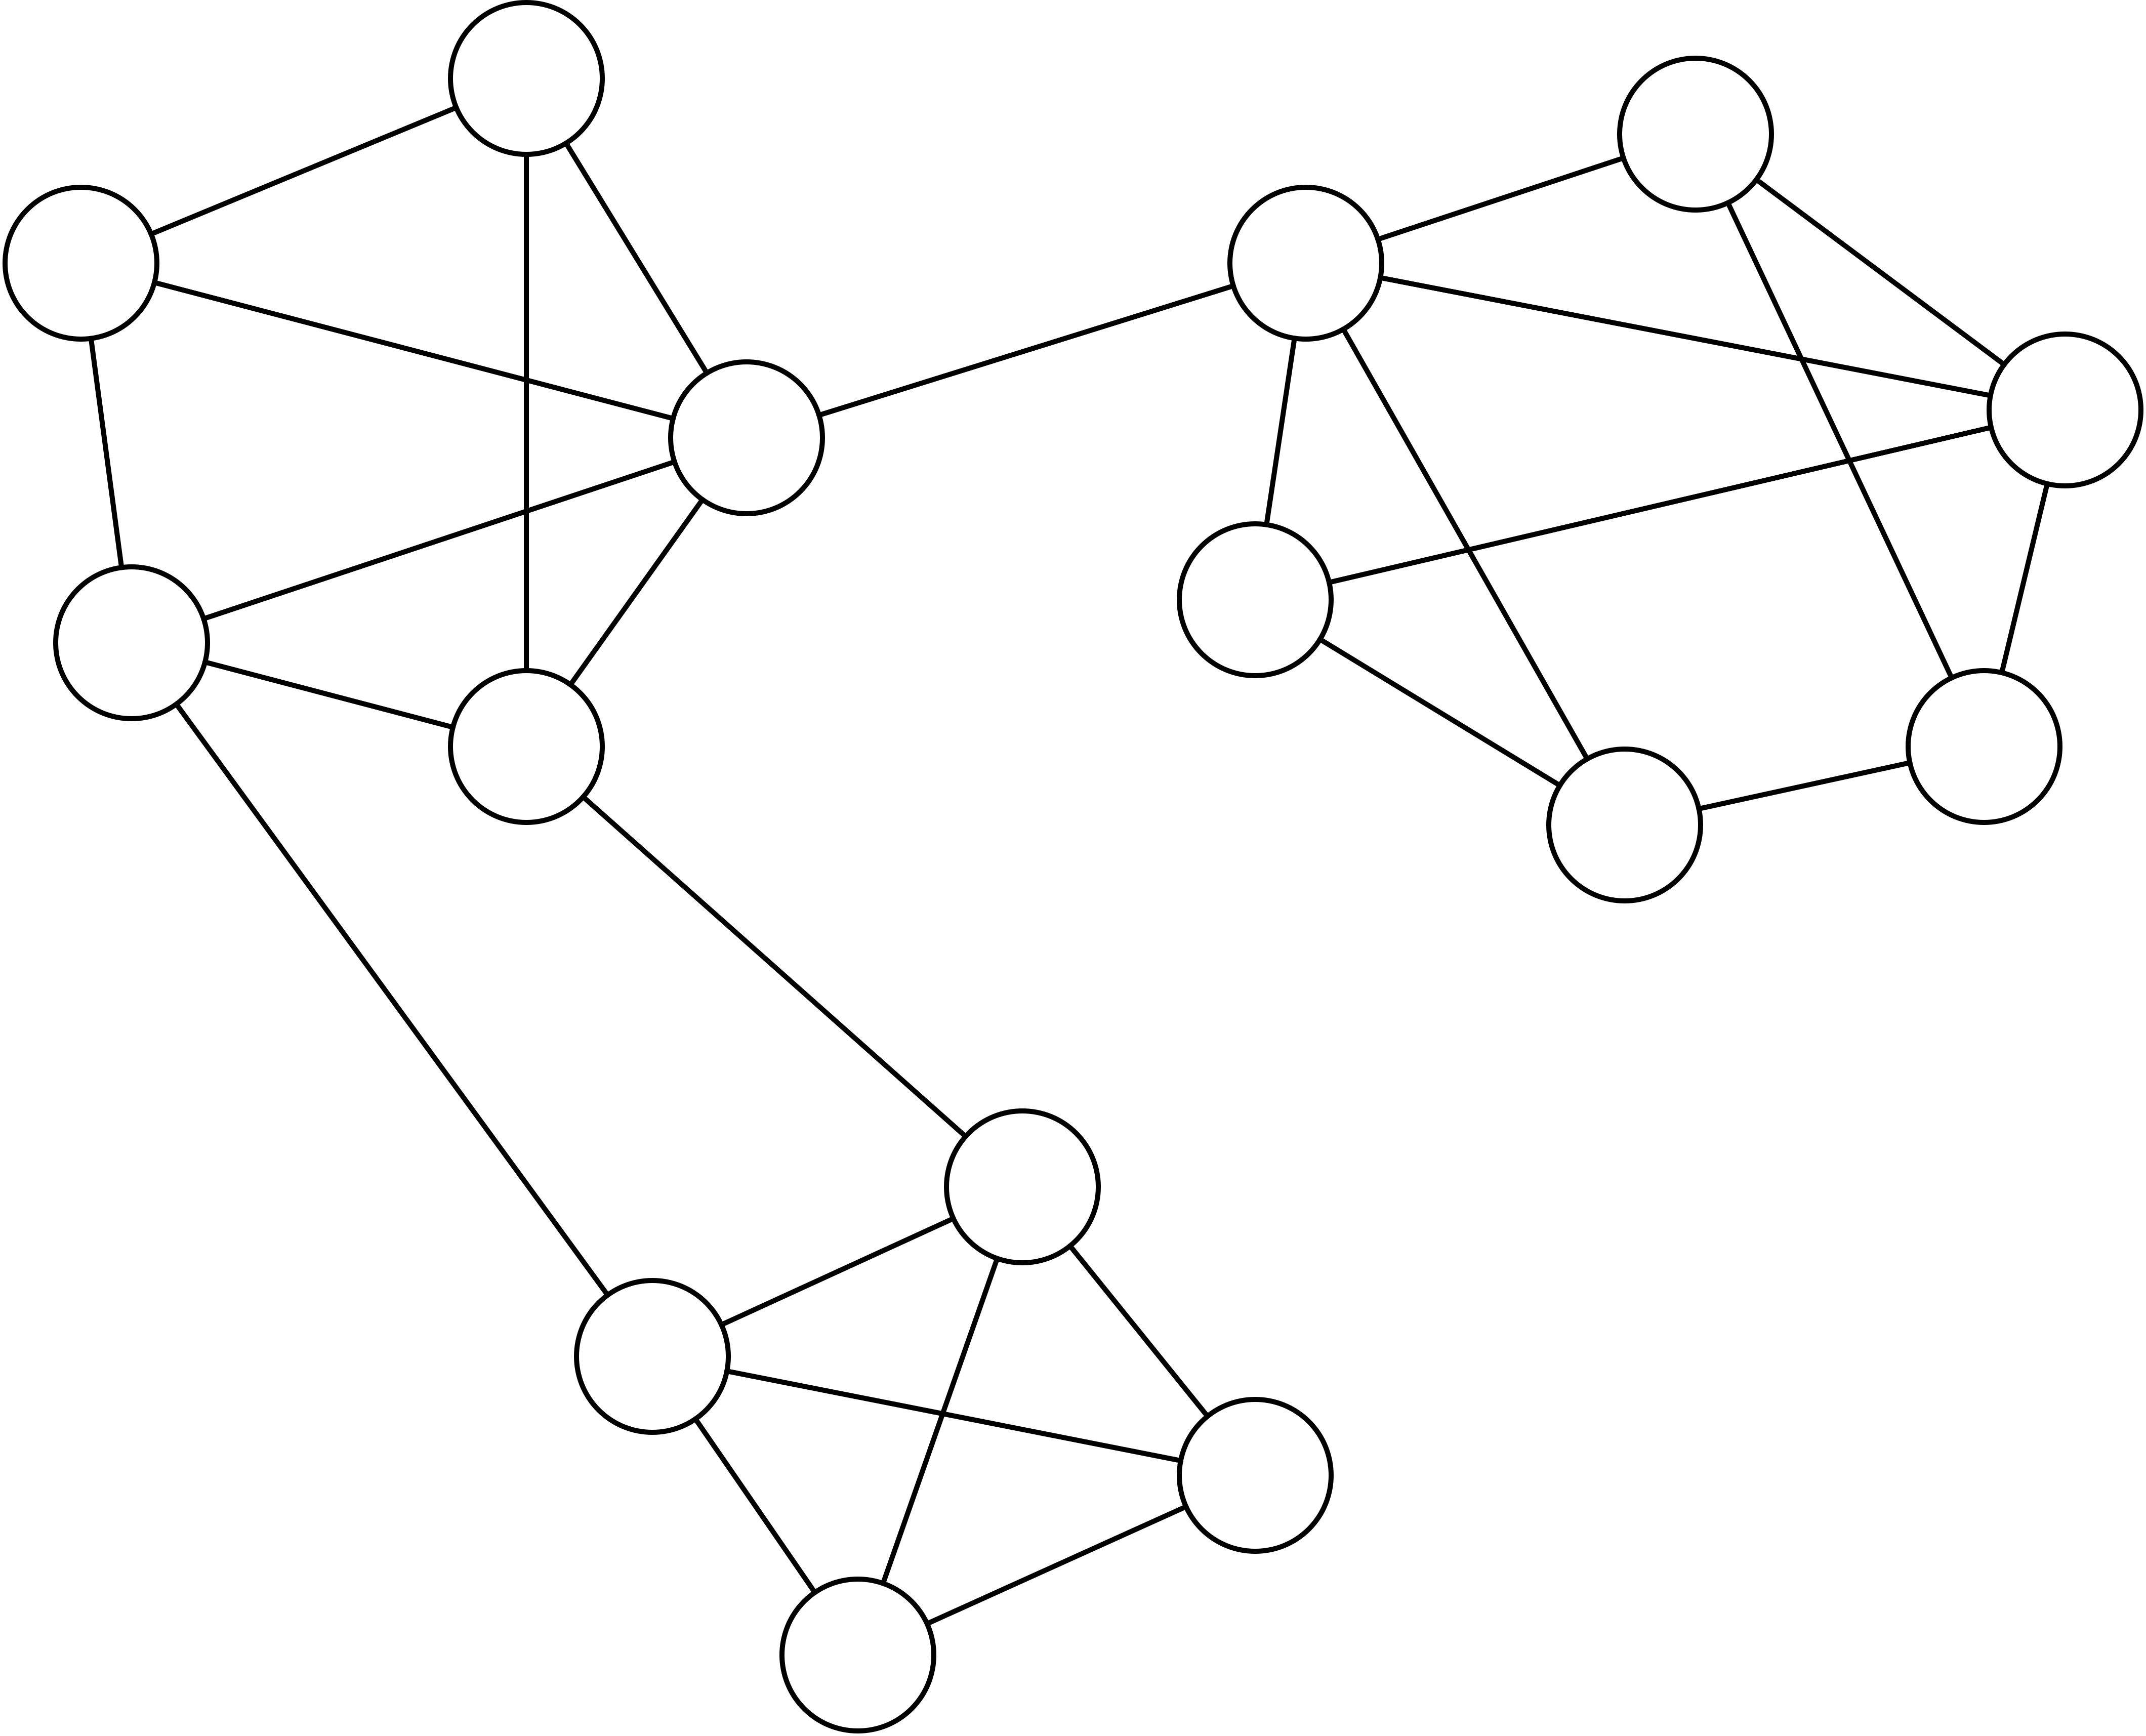
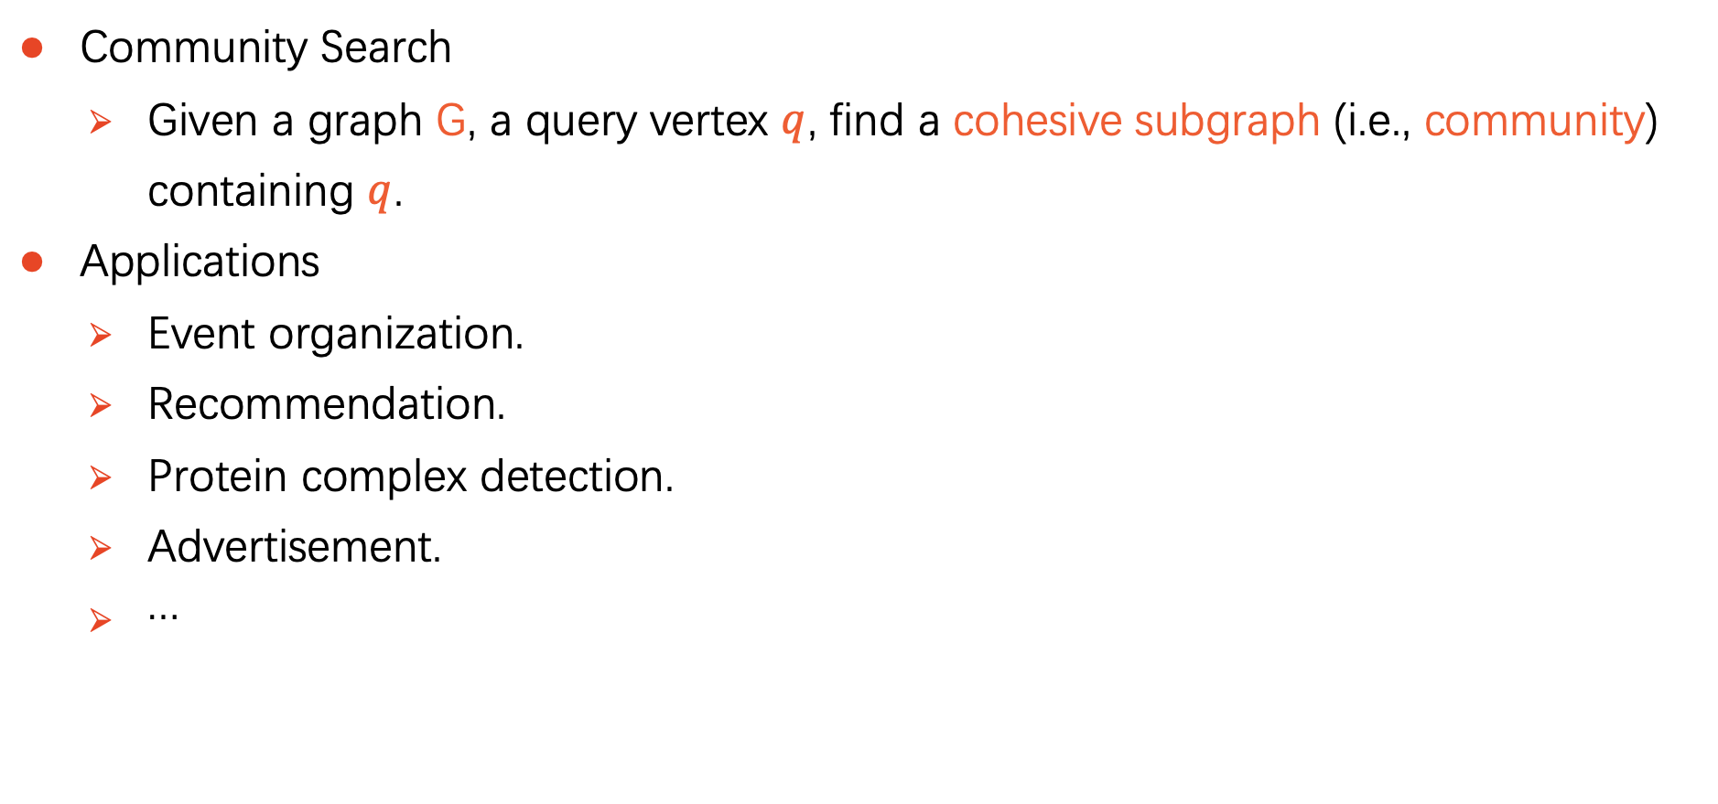

Introduction
Community Search
Given a graph G, a query vertex $q$, find a cohesive subgraph (i.e., community) containing $q$.
Applications
Event organization.
Recommendation.
Protein complex detection.
Advertisement.
…
$$q$$
Notes:
CS is a fundamental problem in graph mining.
Here is a general definition of CS.
For example, in this graph, suppose the query vertex is q, intuitively, the subgraph in the circular area might be a community containing q.
This problem has many applications.

Slide 4
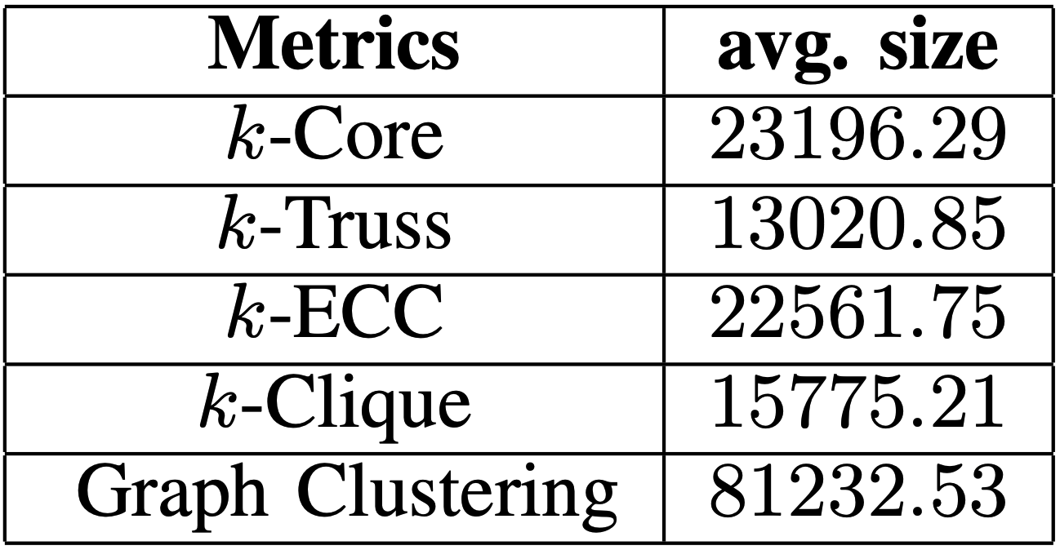
Introduction
Most of the existing studies ignore the size of the community.
Yield communities of very large size, which may overwhelm end-users.
Comparison for CS solutions on Gowalla^{[Conggai et al VLDB 2019]}
Limiting the size of the returned community is natural and interesting from application point of view:
organize a hiking trip with up to 15 attendees.
assemble a team of up to 10 workers for a project.
Notes:
We can see, no matter which cohesiveness metric is used, the average size of the returned community is pretty large.
L’imiting ！！！

Slide 5
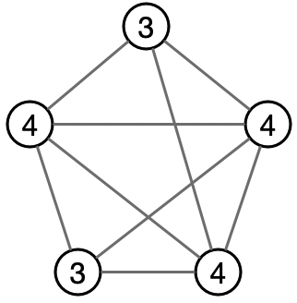
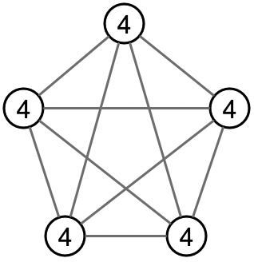

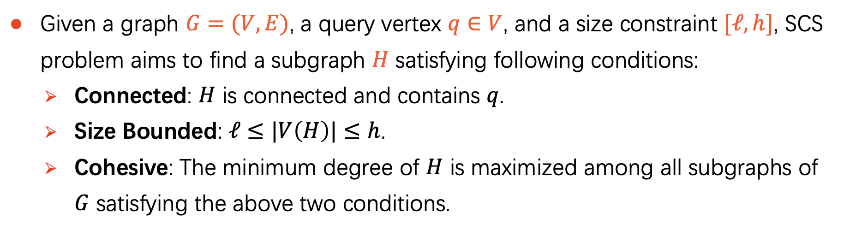
Size-Bounded Community Search (SCS)
Given a graph $G=(V,E)$, a query vertex $q∈V$, and a size constraint $[ℓ,h]$, SCS problem aims to find a subgraph $H$ satisfying following conditions:
Connected: $H$ is connected and contains $q$.
Size Bounded: $ℓ≤|V\left(H\right)|≤h$.
Cohesive: The minimum degree of $H$ is maximized among all subgraphs of $G$ satisfying the above two conditions.
We use minimum degree to measure the cohesiveness of a subgraph.
Min deg = 3
Min deg = 4
Notes:
So, in this paper we study Size Bounded Community Search.
Here is the formal definition of this problem.
Read~
Firstly, read~
Secondly, the number of vertices in H is at least \ell but at most h.
Lastly, read~
Read~
For example, we say the second graph is more cohesive than the first one.

Slide 6
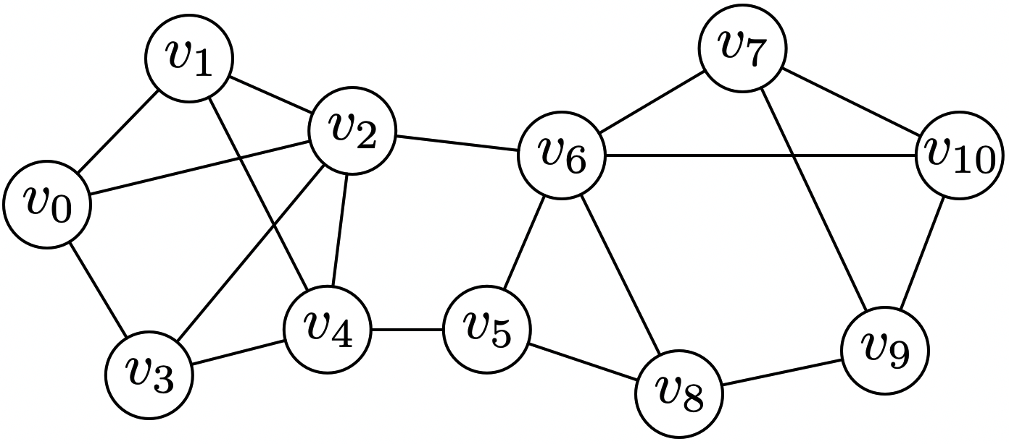
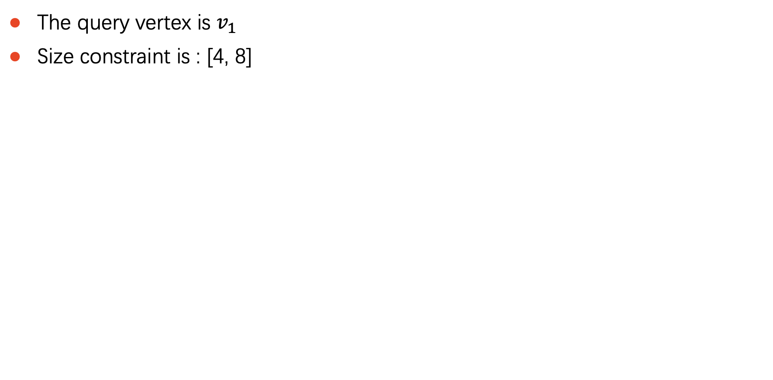
Example
The query vertex is $v_{1}$
Size constraint is : [4, 8]
Size = 4
Minimum degree = 2
Size = 5
Minimum degree = 3
Size = 10
Minimum degree = 3
A social network
Notes:
Let’s see an example.
For this subgraph, it is a feasible solution, whose size is 4 and minimum degree is 2.
For this subgraph, it is better than the previous one, since it has a larger minimum degree 3.
In this example, this subgraph is the optimal solution.
Although the whole graph has minimum degree of 3, it does not satisfy the size constraint.

Slide 7
Hardness
SCS problem is NP-hard.
Notes:
SCS problem is NP-hard.
To solve this problem exactly, we resort to branch and bound algorithm.

Slide 8
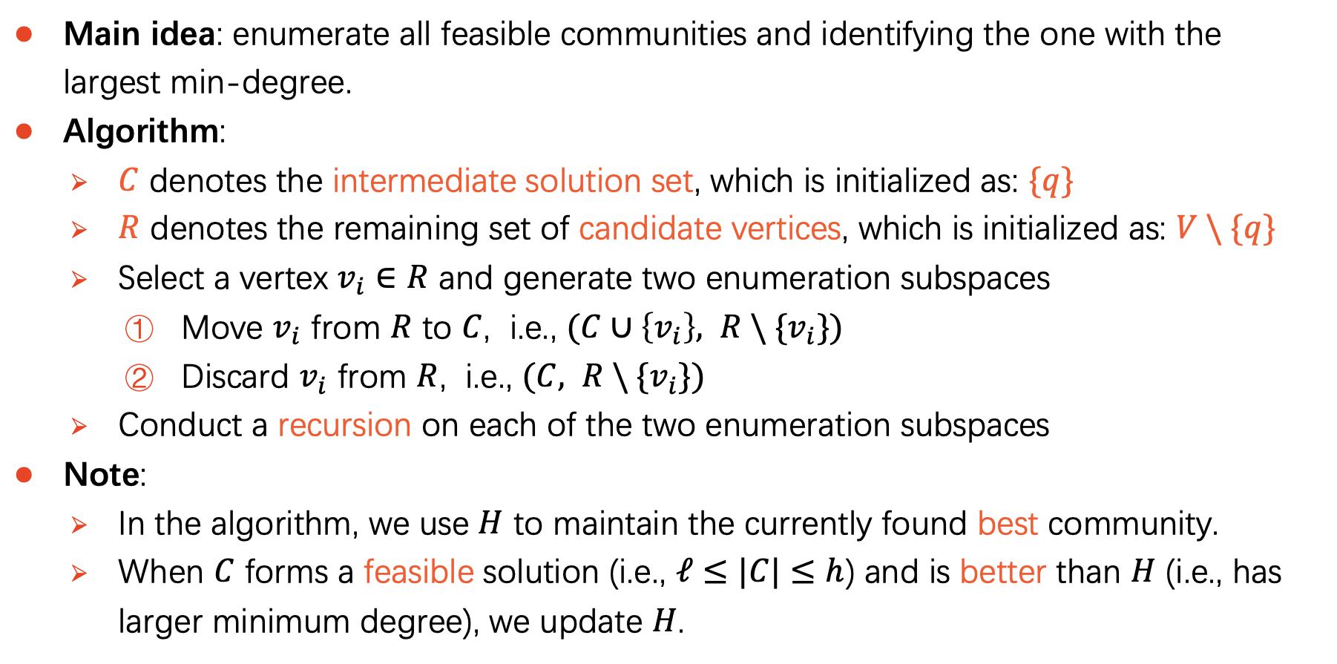
A Basic Enumeration Algorithm
Main idea: enumerate all feasible communities and identifying the one with the largest min-degree.
Algorithm:
$C$ denotes the intermediate solution set, which is initialized as: $\{q\}$
$R$ denotes the remaining set of candidate vertices, which is initialized as: $V \backslash \{q\}$
Select a vertex $v_{i}∈R$ and generate two enumeration subspaces
Move $v_{i}$ from $R$ to $C$, i.e., $(C∪\left\{v_{i}\right\}, R \backslash \{v_{i}\})$
Discard $v_{i}$ from $R$, i.e., $(C, R \backslash \{v_{i}\})$
Conduct a recursion on each of the two enumeration subspaces
Note:
In the algorithm, we use $H$ to maintain the currently found best community.
When $C$ forms a feasible solution (i.e., $ℓ≤|C|≤h$) and is better than $H$ (i.e., has larger minimum degree), we update $H$.
Notes:
Firstly, let’s see a basic enumeration algorithm.

Slide 9
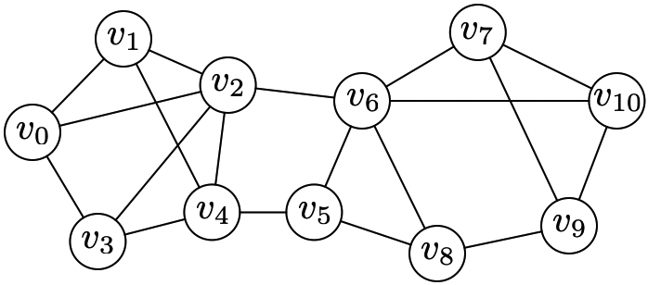
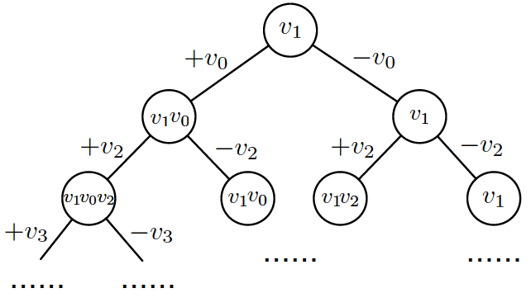
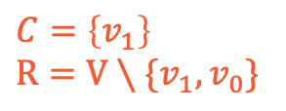
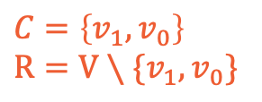
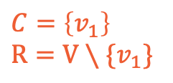
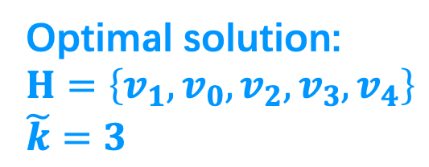
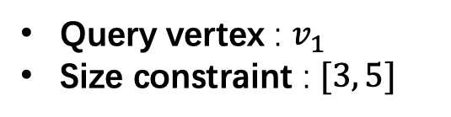
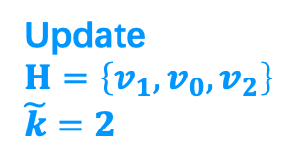
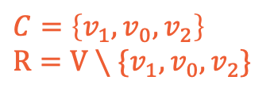
Example
$C=\left\{v_{1}\right\}$
$R=V∖\{v_{1}\}$
$C=\left\{v_{1},v_{0}\right\}$
$R=V∖\{v_{1},v_{0}\}$
$C=\left\{v_{1}\right\}$
$R=V∖\{v_{1},v_{0}\}$
$C=\left\{v_{1},v_{0}, v_{2}\right\}$
$R=V∖\{v_{1},v_{0}, v_{2}\}$
Update
$H=\left\{v_{1},v_{0}, v_{2}\right\}$
$\tilde{k}=2$
Query vertex : $v_{1}$
Size constraint : $[3, 5]$
Optimal solution:
$H=\left\{v_{1},v_{0}, v_{2}, v_{3}, v_{4}\right\}$
$\tilde{k}=3$
Limitations:
Large search space
Binary search tree
No pruning based upper bound
Naive branching rule
Notes:
For example, in this graph, the query vertex is v1, the size constraint is [3,5]
The enumeration process can be depicted as a binary search tree, where the root is the query vertex v1.
On each tree node, we generate two subtrees, move a vertex from R to C, or discard it.
During the enumeration process, when we find a better solution, we use H and k_tilde to record the feasible solution and its minimum degree.
When all the feasible solutions have been explored. Finally

Slide 10
Our Contribution
Reducing techniques
Remove unpromising vertices from candidate set.
Upper bounding techniques
Prune unpromising branches.
Domination-based branching
Reduce the number of branches.
Notes:
So in this paper, we propose the following techniques to facilate the computation.
Read~
In this presentation, I will only introduce the UB techniques.

Slide 11
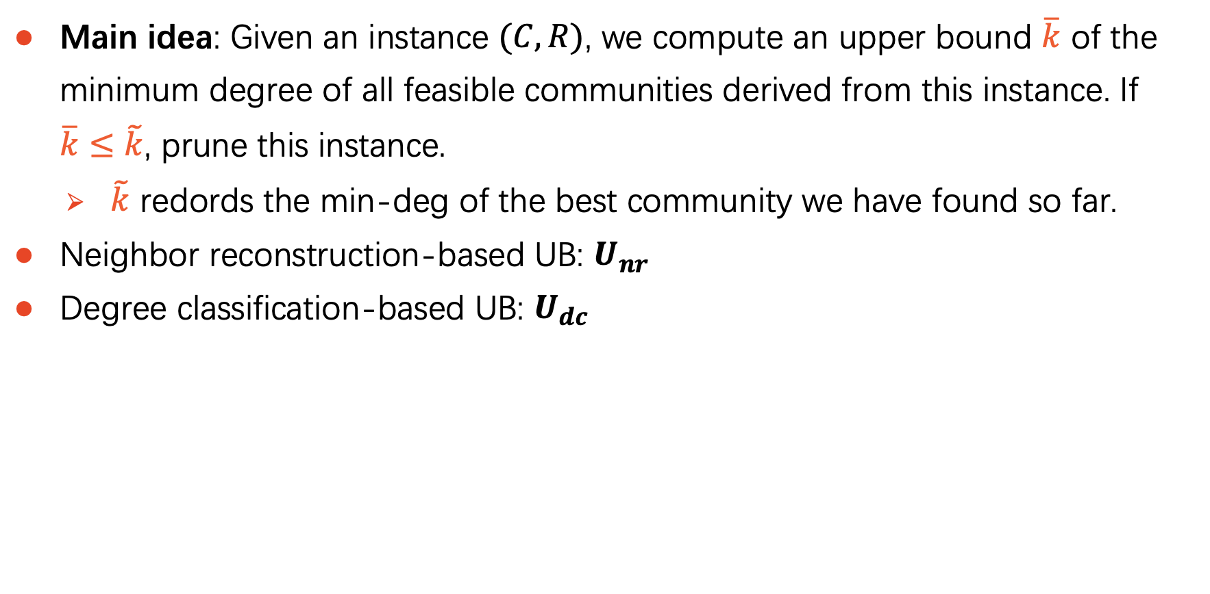
Upper Bound Technique
Main idea: Given an instance $(C,R)$, we compute an upper bound $\overline{k}$ of the minimum degree of all feasible communities derived from this instance. If $\overline{k}≤\tilde{k}$, prune this instance.
$\tilde{k}$ redords the min-deg of the best community we have found so far.
Neighbor reconstruction-based UB: $U_{nr}$
Degree classification-based UB: $U_{dc}$
Notes:
We design two upper bounds: Unr and Udc

Slide 12
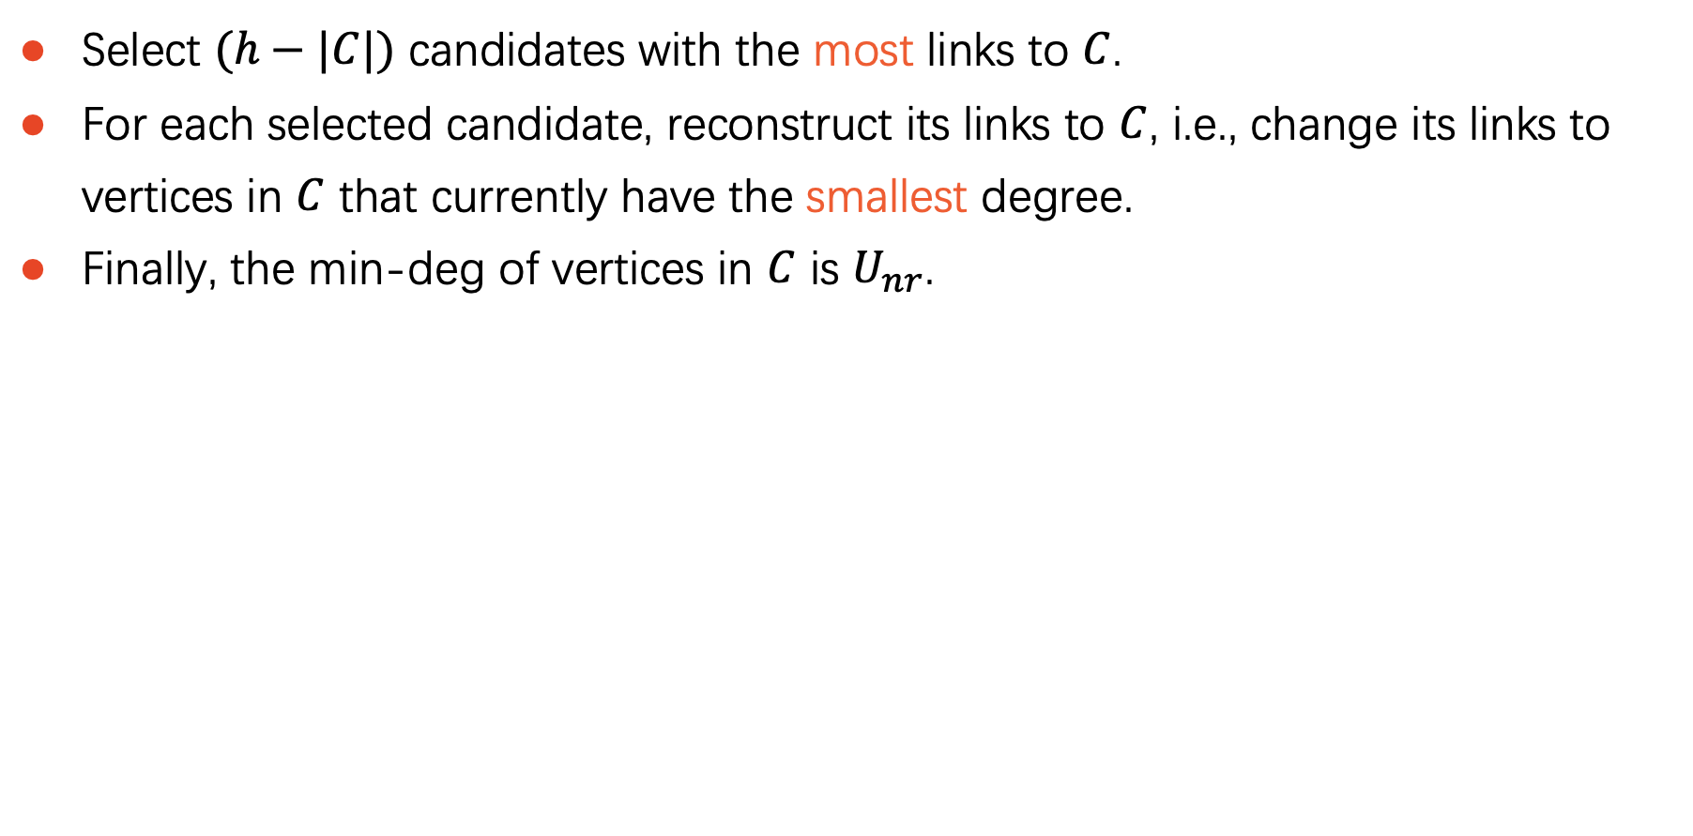

Neighbor Reconstruction-based UB: $U_{nr}$
Select $(h−|C|)$ candidates with the most links to $C$.
For each selected candidate, reconstruct its links to $C$, i.e., change its links to vertices in $C$ that currently have the smallest degree.
Finally, the min-deg of vertices in $C$ is $U_{nr}$.

Slide 13
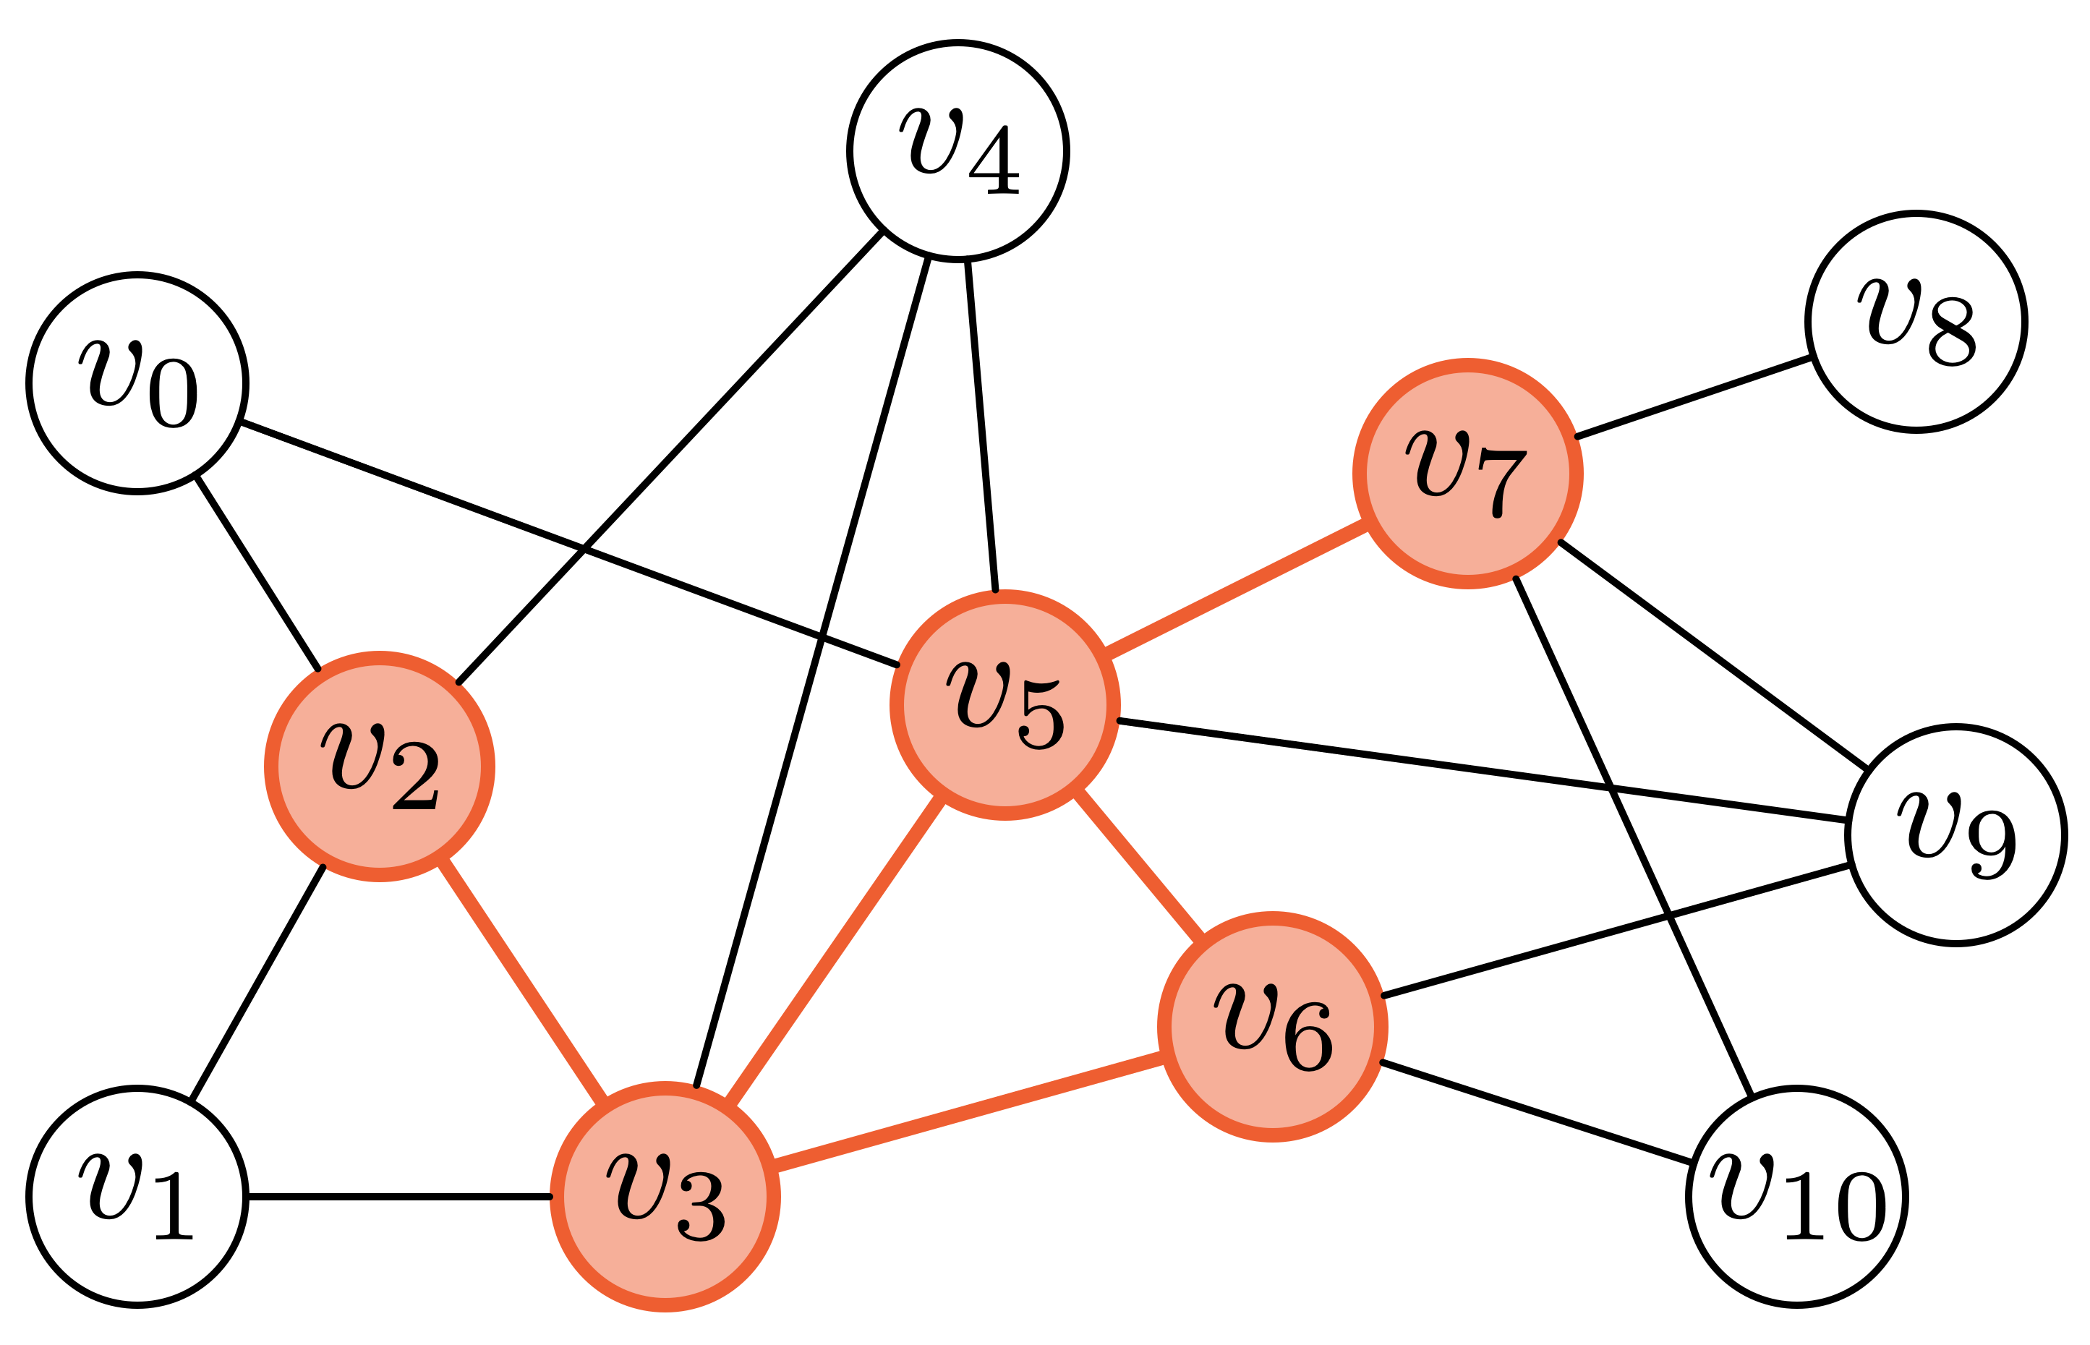
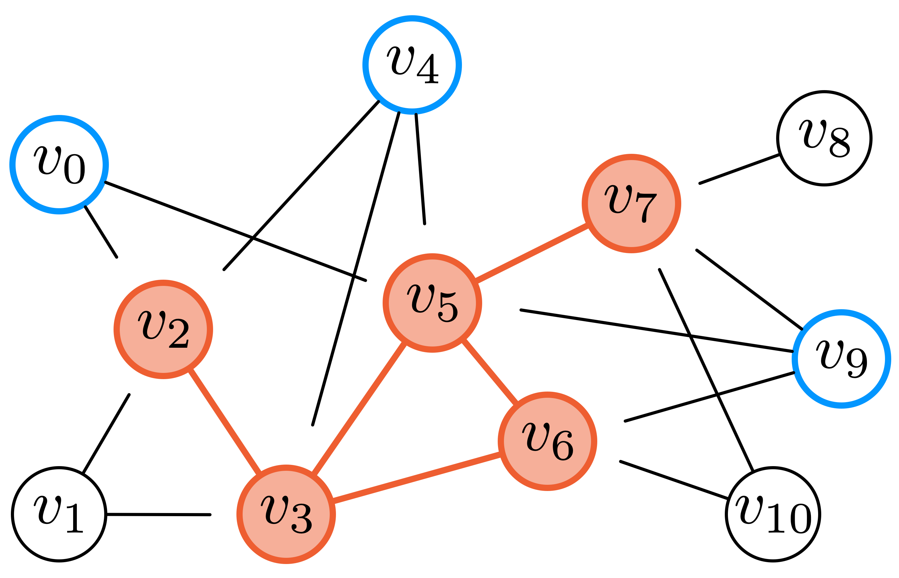
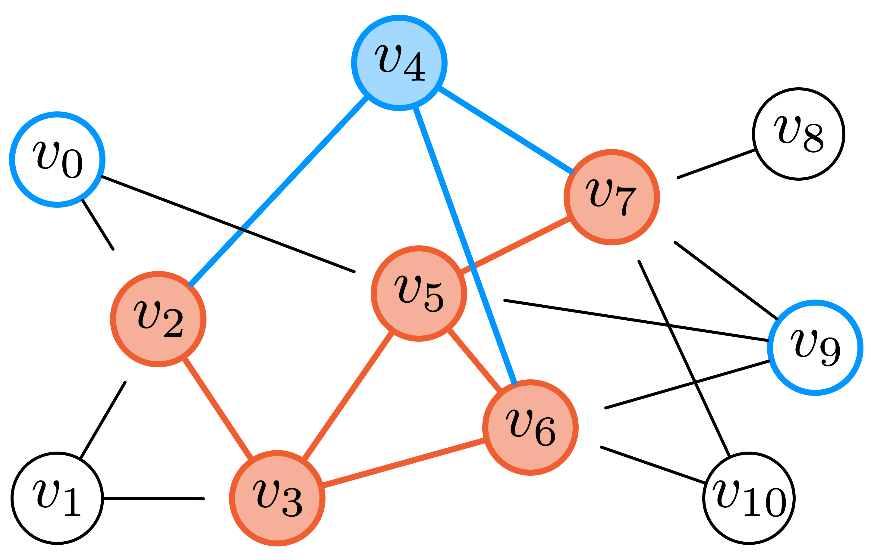
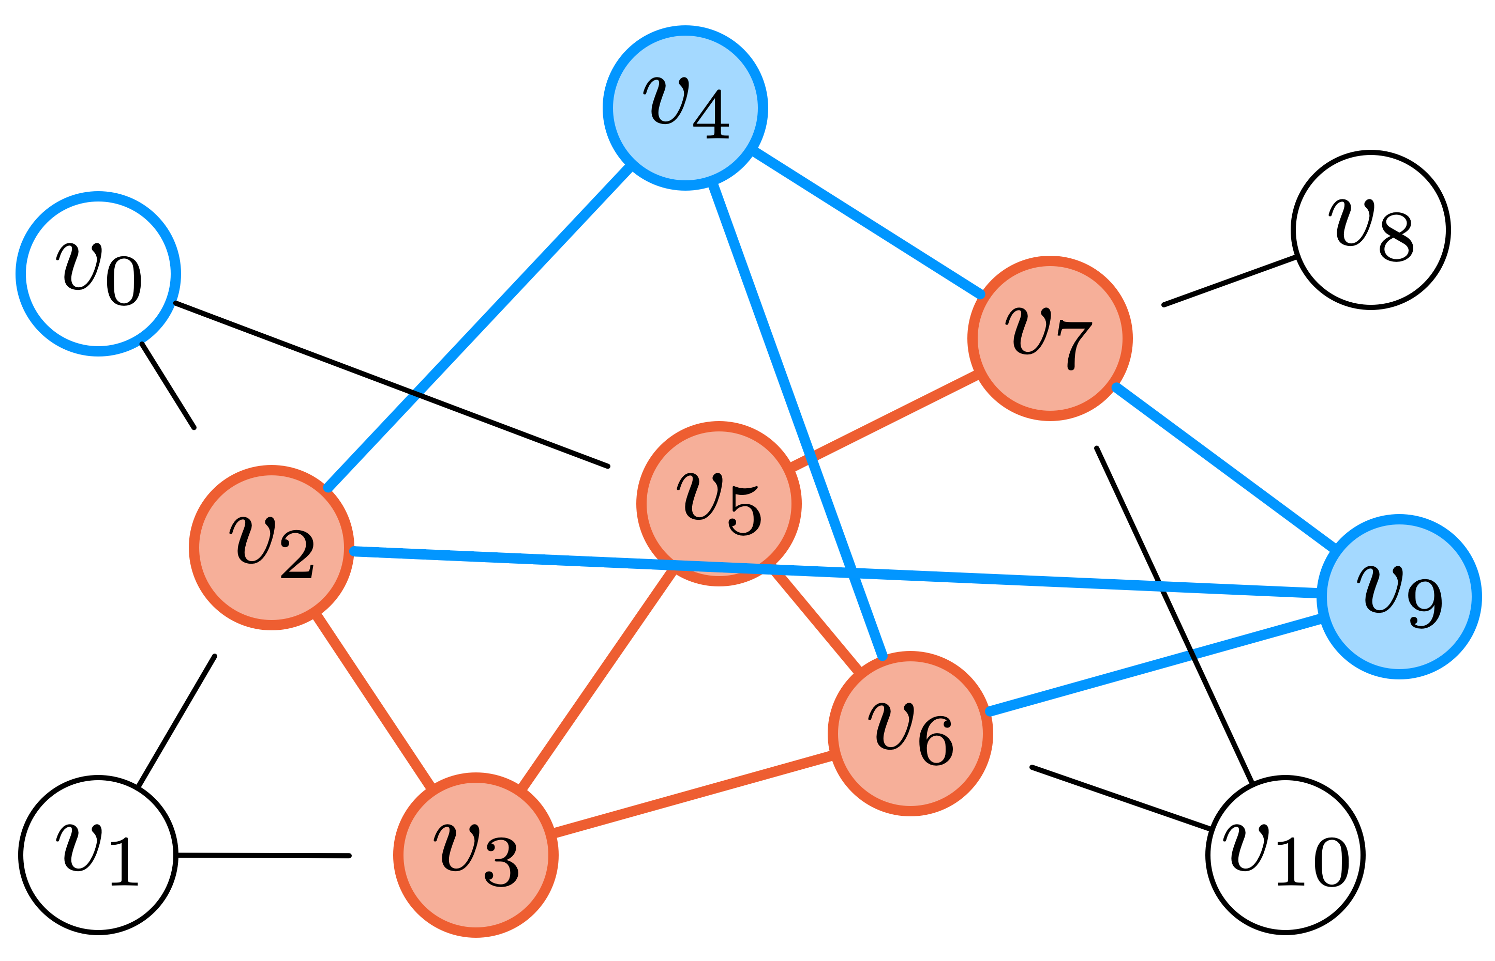
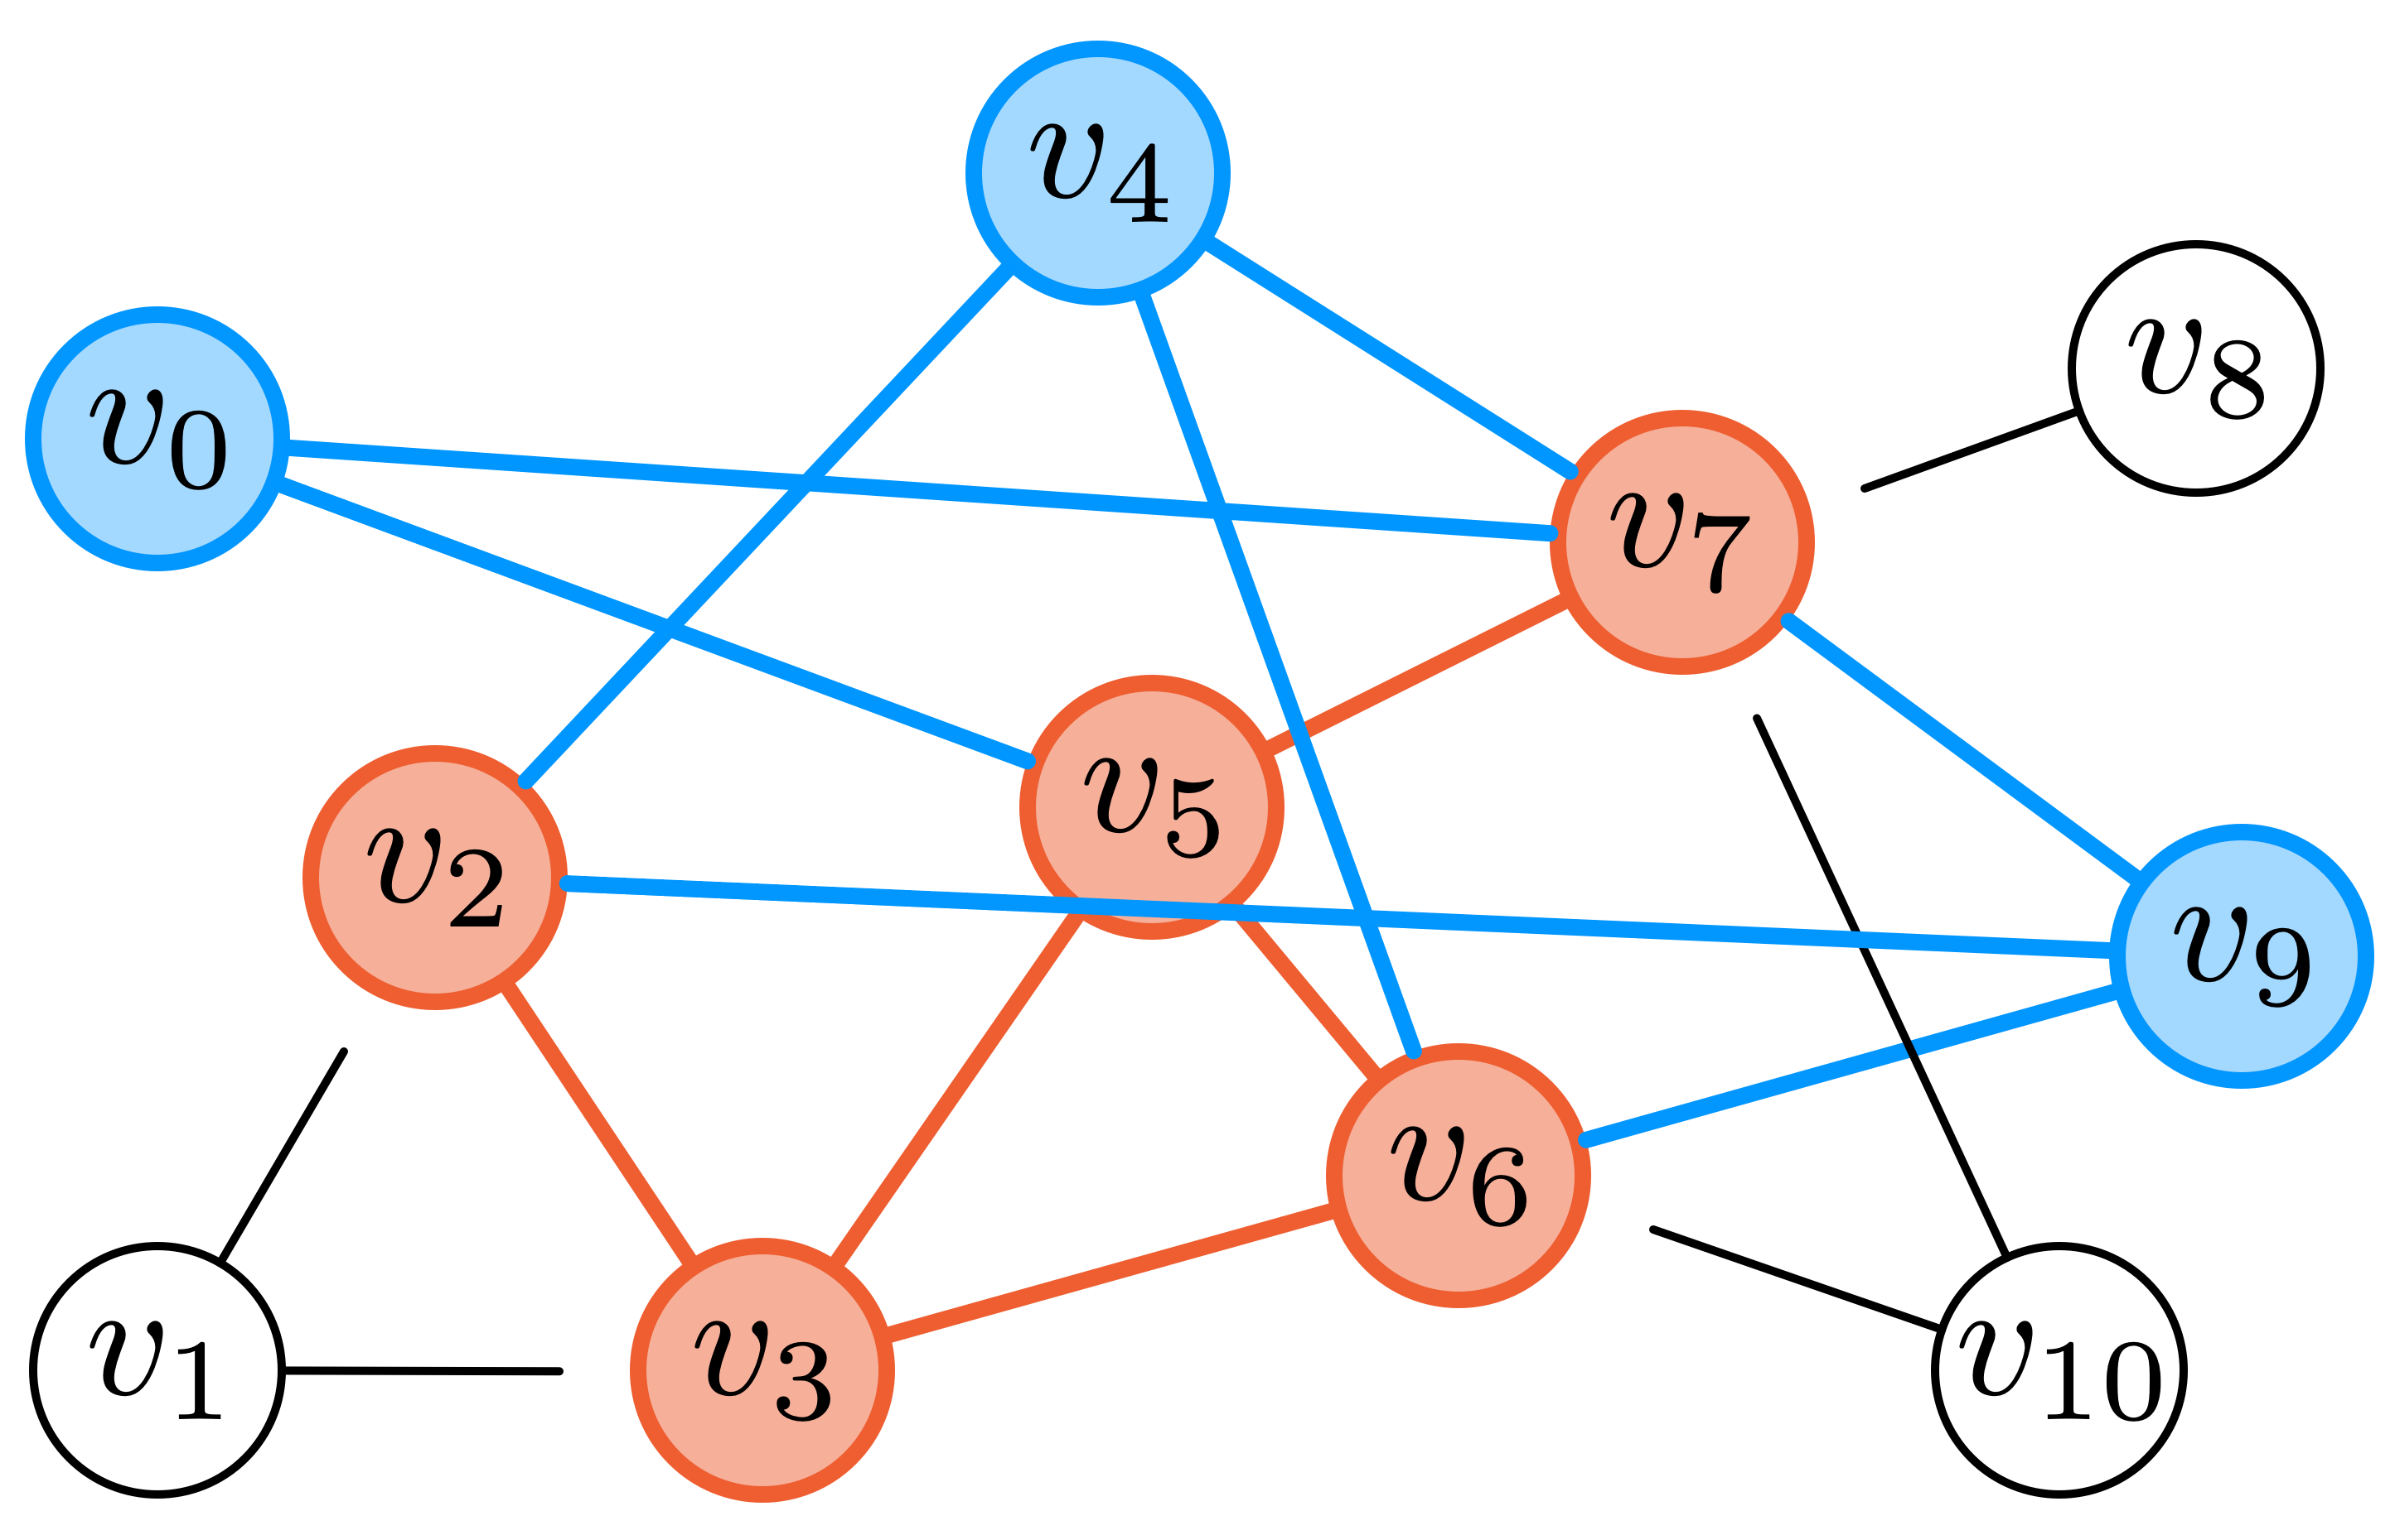
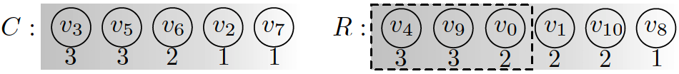
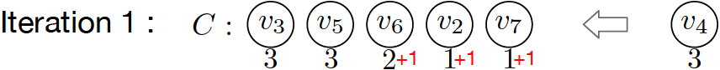
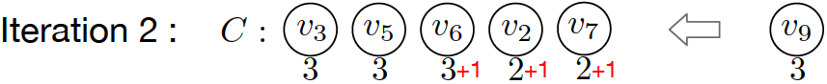
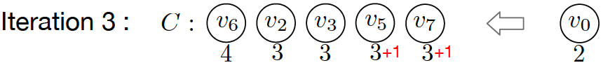
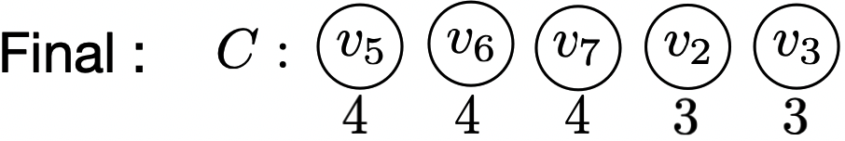
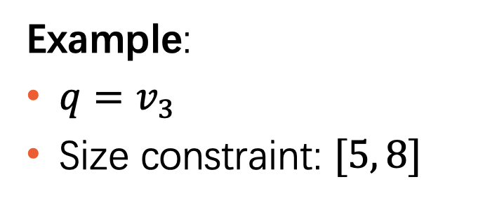

Neighbor Reconstruction-based UB: $U_{nr}$
Example:
$q=v_{3}$
Size constraint: $[5, 8]$
$$U_{nr}=3$$
Notes:
Which means the best community we can drive from this instance has minimum degree of 3.

Slide 14
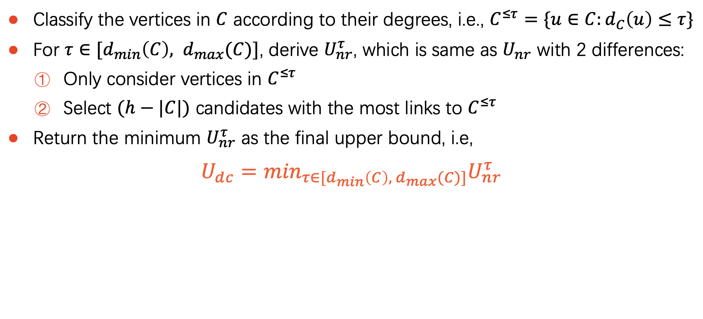

Degree Classification-based UB: $U_{dc}$
Classify the vertices in $C$ according to their degrees, i.e., $C^{≤τ}=\{u∈C:d_{C}\left(u\right)≤τ\}$
For $τ∈[d_{min}\left(C\right), d_{max}(C)]$, derive $U_{nr}^{τ}$, which is same as $U_{nr}$ with 2 differences:
Only consider vertices in $C^{≤τ}$
Select $(h−|C|)$ candidates with the most links to $C^{≤τ}$
Return the minimum $U_{nr}^{τ}$ as the final upper bound, i.e,
$$U_{dc}=\min_{τ∈[d_{min}\left(C\right), d_{max}(C)]}U_{nr}^{τ}$$
Notes:
C^nolargthanT represents vertices whose degree in C is no larger than T

Slide 15
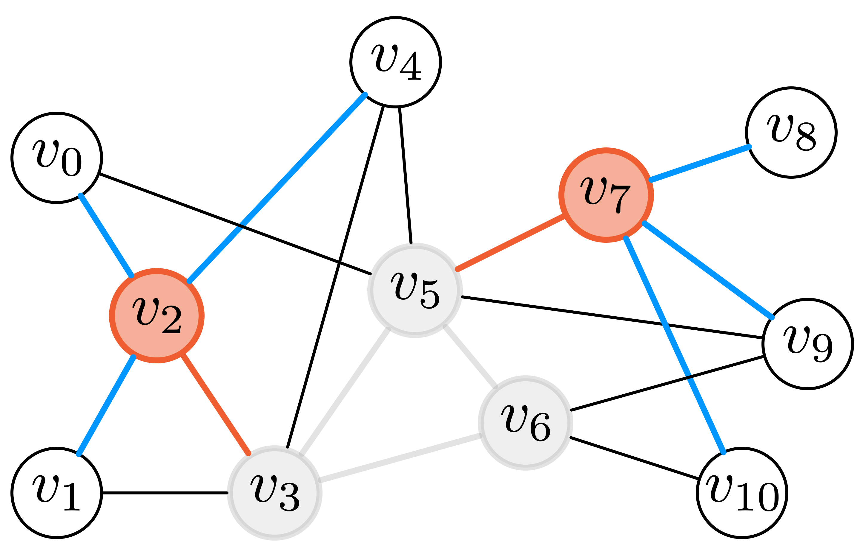
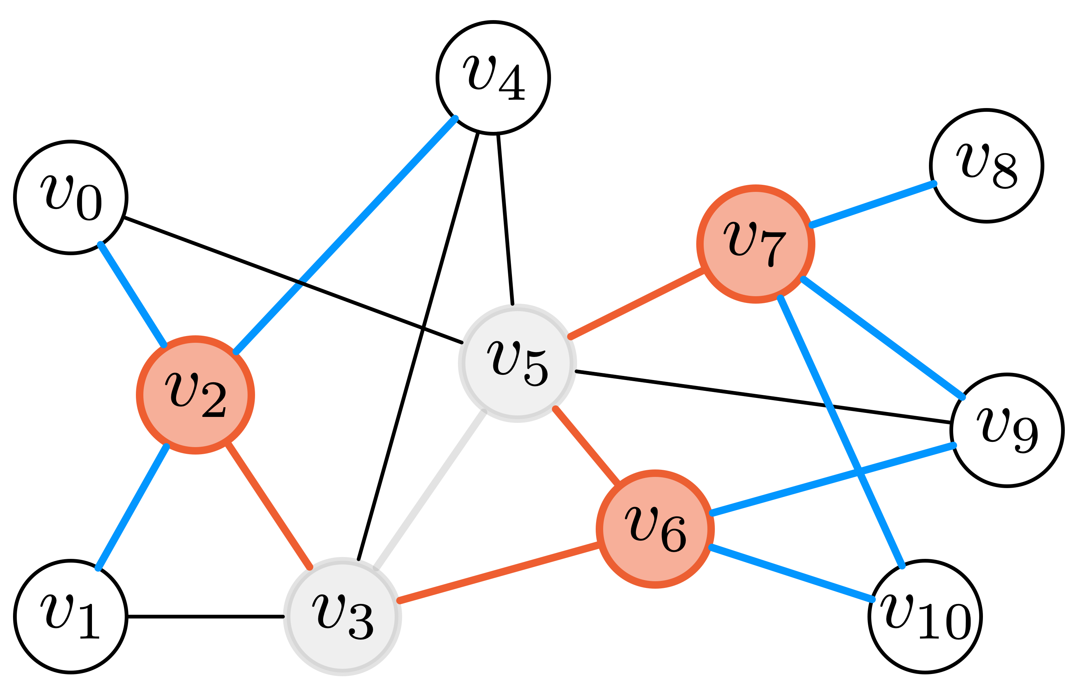
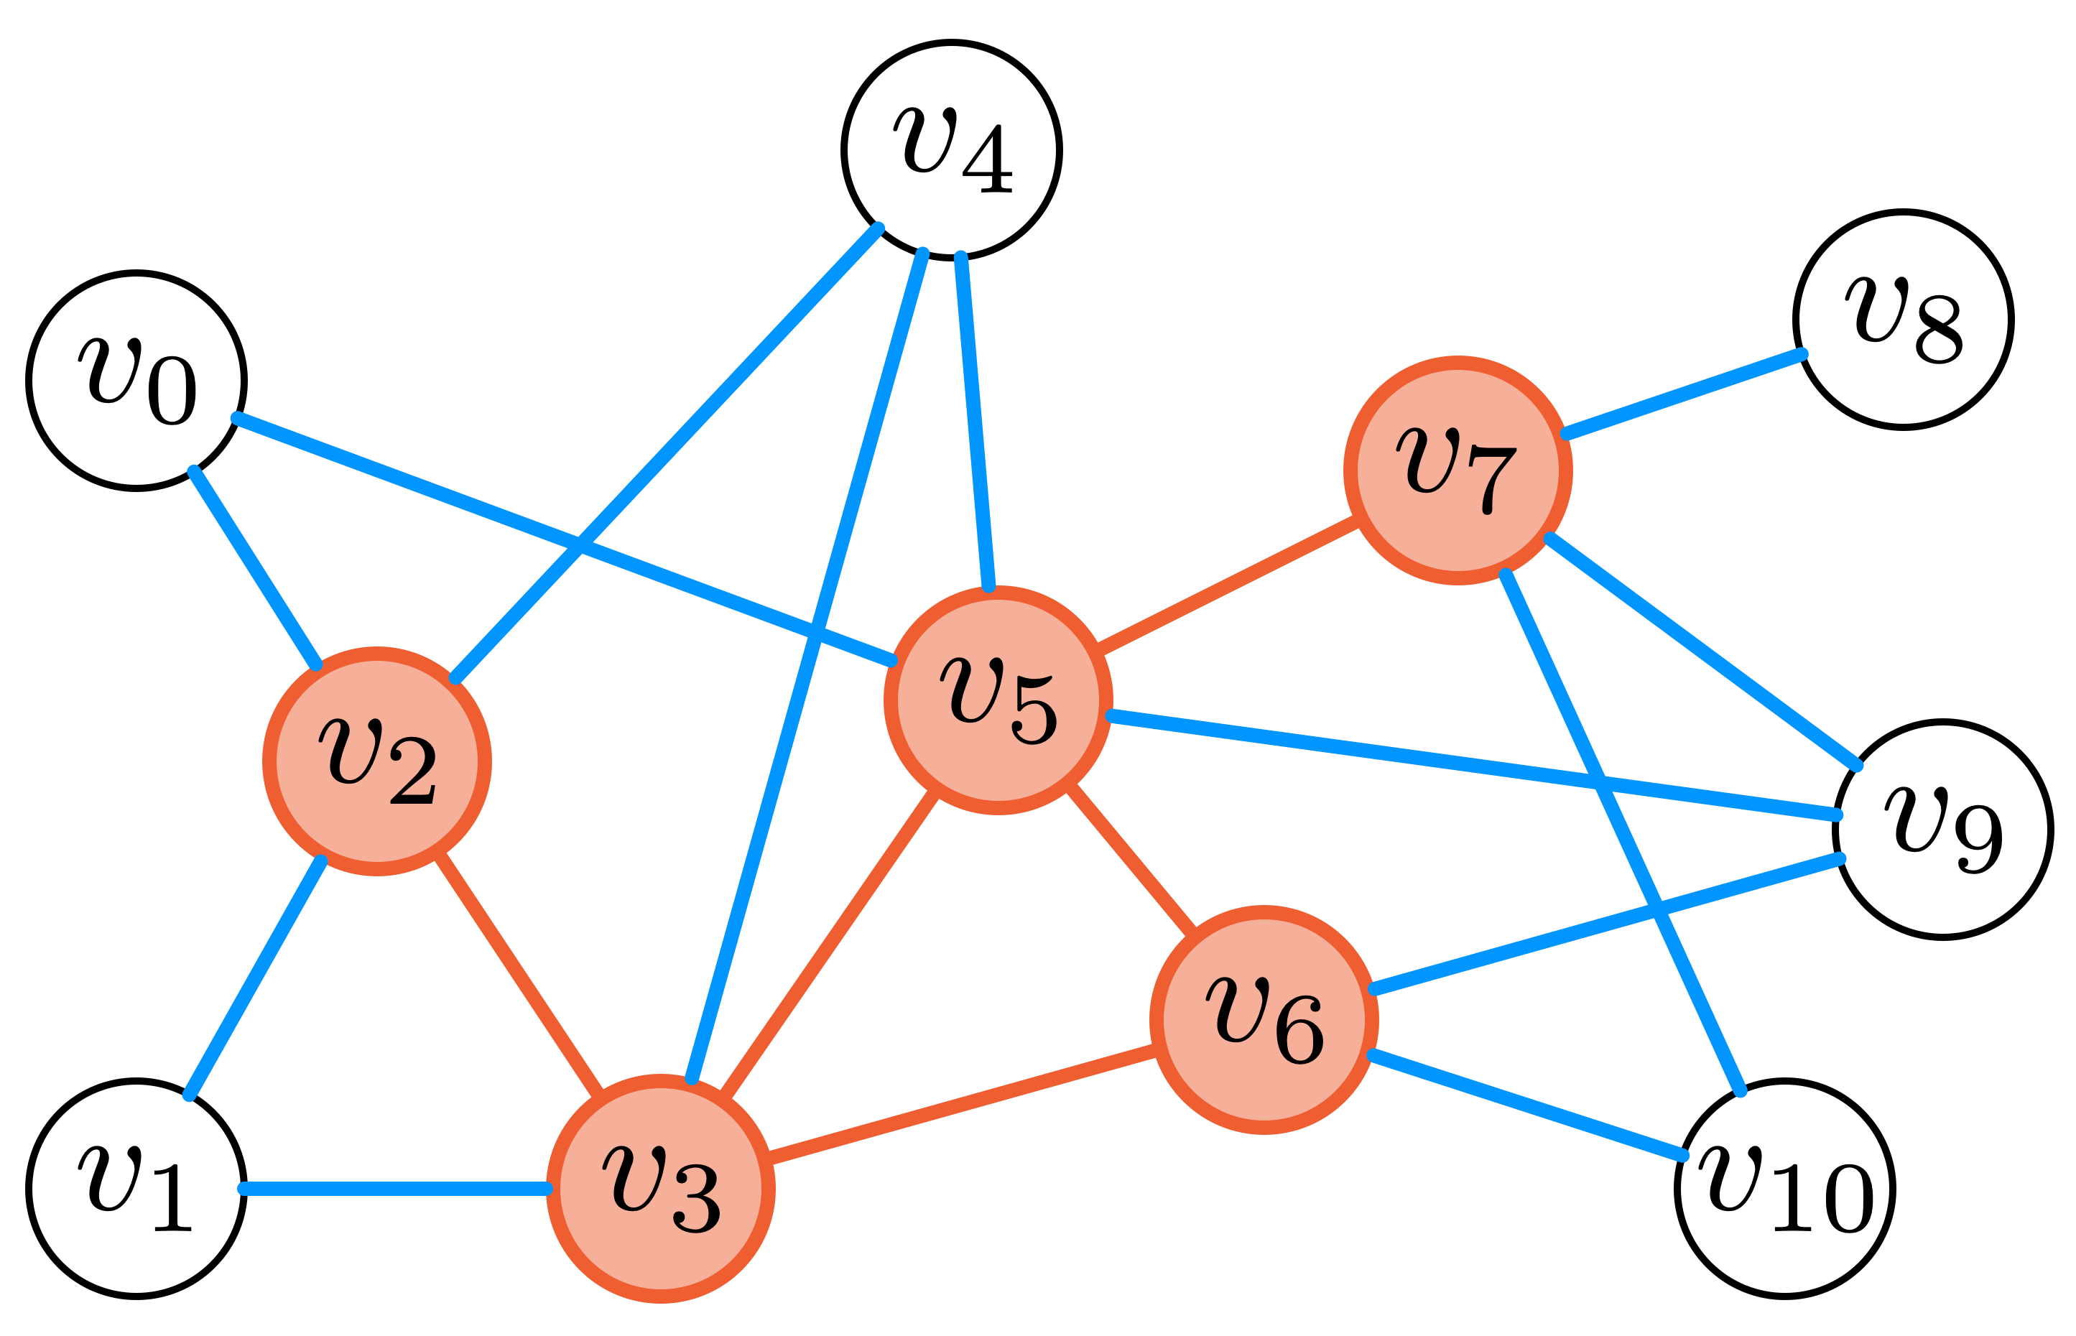
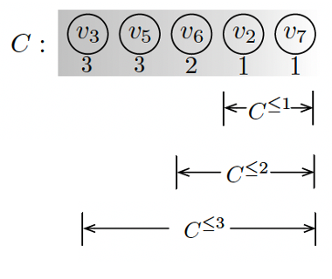
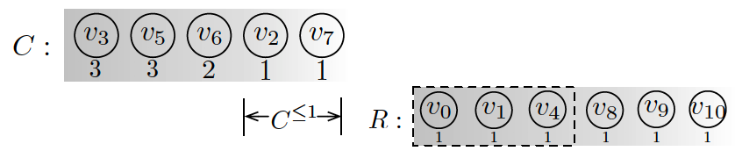
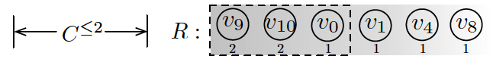
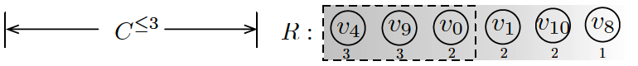
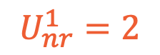
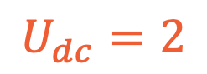
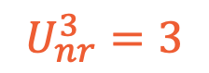
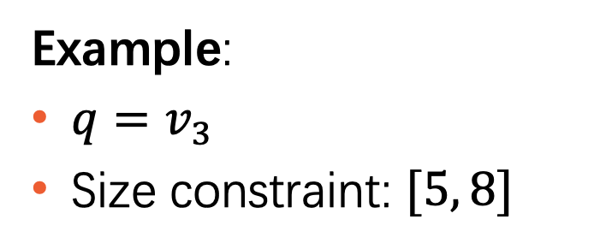
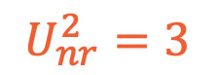
Degree Classification-based UB: $U_{dc}$
Example:
$q=v_{3}$
Size constraint: $[5, 8]$
$$U_{nr}^{1}=2$$
$$U_{nr}^{2}=3$$
$$U_{nr}^{3}=3$$
$$U_{dc}=2$$
Notes:
Same exapmle

Slide 16
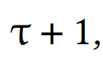
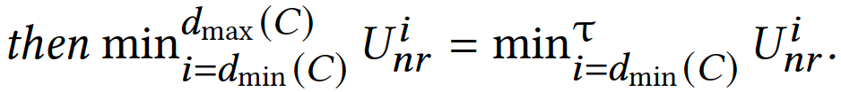



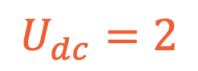
Optimization on the computation of $U_{dc}$
Example:
$q=v_{3}$
Size constraint: $[5, 8]$
$$U_{nr}^{≤1}=2$$
$$U_{dc}=2$$

Slide 17

Experiments
Algorithms:
GreedyF and GreedyD: Two heuristic algorithms proposed in [Mauro et al KDD 2010].
SC-Enum: Our baseline algorithm.
SC-BRB: Our branch and bound algorithm.
Platform: C++, Ubuntu system, Intel Core-i7 3.20GHz CPU, 64GB memory.
Datasets:
Notes:
All algorithms are implemented in C++.

Slide 18

Effectiveness Evaluation
Notes:
Firstly, it is effectiveness evaluation.
We evaluate the minimum degree and edge density of the returned communities with size constraint of [9,12]
our exact algorithm SC-BRB has the highest result quality.

Slide 19

Efficiency Evaluation
SC-BRB/R: SC-BRB without our reduction techniques.
SC-BRB/U: SC-BRB without our upper bounding techniques.
SC-BRB/D: SC-BRB without our domination based branching.
Notes:
To evaluate different techiniques used in SC-BRB, we implement the following algorithms.
We can see that each of the techniques contributes to the efficiency of SC-BRB.

Slide 20

Comparison with PSA
PSA: the progressive algorithm proposed in [Conggai et al VLDB 2019] for (approximately) computing a minimum 𝑘-core.
Notes:
Here we report the performance of PSA with different approximation ratio, 1.2 and 1.01, respectively.
Intuitively, the smaller the value of approximation ratio, the longer the running time, the better the result quality.
SC-BRB outperforms PSA(1.2) in terms of both result quality and running time.
PSA(1.01) has the same result quality as SC-BRB due to the small value of a r, but is much slower than our algorithm.
We adapt PSA for SCS without size lower bound, by computing
an approximate minimum𝑘-core for an iteratively increasing 𝑘 until
the size of the identified subgraph is larger than ℎ.

Slide 21
Conclusion
We study the problem of size-bounded community search which has both size lower bound and size upper bound.
We propose a branch-reduce-and-bound algorithm SC-BRB for solving the problem over large real graphs.
Extensive experiments on large real graphs demonstrate the effectiveness and efficiency of our proposed algorithm.

